Slide 1



Federated-Cloud Based Deep Neural Networks with Privacy Preserving Image Filtering Techniques
Isabelle Choi, Qiyang Song, and Kun Sun
Notes:
Good afternoon, everyone. It‘s my pleasure to make a presentation here. My name is Qiyang Song. I come from Tsinghua University. Currently, I am also a visiting student in George Mason University. This work was conducted by Isabelle Choi, Qiyang Song and Kun Sun. The first author is an intern in our research group under my guidance. She has not got a visa yet, so I present this work on behalf of her. This work studies how to protect user data in cloud based DNN training via image filtering techniques, and also propose a method to balance privacy and DNN accuracy.

Slide 2
Outline
Background
Challenges and Goals
Overview of Privacy Protection
Identification of Similarity Metrics
Federated Cloud Based DNN Models
Experiments
Notes:
Now, let's get started. This is the outline. First, I’ll introduce you some background about cloud based DNN training and related privacy protection on user data. Then, I'll introduce the challenges, the goals, the overview and our methods to balance user privacy and DNN accuracy. Finally, I’ll show some experiment results.

Slide 3
Popularity of Deep Neural Networks
Various Application Domains
Computer Vision
Automatic Speech Recognition
Natural Language Processing
Resource Intensive Machine Learning
Cloud based Training / Classification
Commercial Clouds with Tailored Machine Learning Service
Notes:
As you know, Deep Neural Network is a popular data analytic tool, which can automatically extract features from datasets. Nowadays, DNN is applied to a variety of applications domains, such as computer vision, automatic speech recognition, and natural language processing. In many instances, DNN model training relies on big data and a large number of computation resources. Some individuals do not always have a GPU server to train a well-performance DNN model, so they will choose a powerful cloud to train DNN models instead of themselves. Recently, many tailored machine learning services are emerging in many commercial clouds, e.g., Google, Amazon and Azure.

Slide 4
Cloud based Machine Learning
Computation-efficient Machine Learning
Users upload local data
Powerful clouds train a model / classify data
Privacy Concerns
Sensitive Data
Medical Records
Private Photos
Untrusted Clouds
Privacy Protection is vital
iCloud Photo Breach
Notes:
In cloud-based machine learning service, users can upload their data to clouds, and then clouds can dedicate many computation resources to make a fast training and classification. Although it is very fascinating to resource limited users, user sensitive data, e.g., medical records or private photos, may be leaked by untrusted clouds or stolen by unexcepted adversaries. In recent years, many events of data breaches have proved that. In 2014, iCloud leaked personal photos of many celebrities. More recently, a big America Bank–Capital One, has been accused of leaking the personal information of nearly 100 million customers and applicants. Therefore, it is vital to provide privacy protection on user data.

Slide 5
Existing Privacy Protection
Fully Homomorphic Encryption (FHE)
Model and data are encrypted
Secret training / classification on a cloud
Expensive computation overhead
Secure Multi-party Computation (MPC)
Secretly share model and data into multiple clouds
Secret classification / training across multi-clouds
Expensive communication overhead
Notes:
There are two existing privacy protection methods on user data. The first one is based on an advanced cryptographic scheme, fully homomorphic encryption (FHE). It allows an untrusted cloud to execute homomorphic addition and multiplication on encrypted data without learning any plaintext. So, a user can outsource secret training and classification to a cloud. However, this method is not practical since it incurs expensive computation overhead. And the other one method is based on secure multi-party computation (MPC). MPC allows a user to secretly share its data and parameters of DNN models to multiple clouds, and the clouds can execute secret classification and training without learning any plaintext. The method is not perfect either. It incurs expensive communication overhead and relies on the setting of non-colluding clouds.

Slide 6
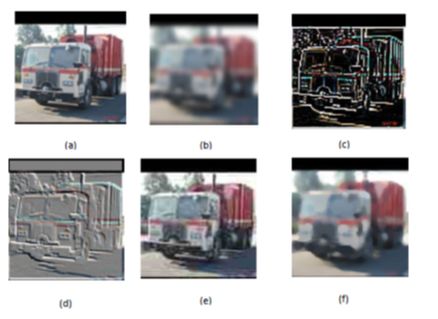
Application-Specific Privacy
Relaxed Security Requirement for Some Applications
Some features related to personal information should be protected
Other irrelevant features can be exposed
Vehicle model classification
Protecting Data via Image Filtering (a.k.a. Distortion)
filtering
Notes:
Therefore, many users tend to relax the security requirements and they only need application-specific privacy protection. Application-specific privacy protection means the privacy protection level varies with different applications. In many applications, only some features related to personal privacy should be protected, other irrelevant features can be exposed. In addition, some machine learning tasks only need subsets of features to train a good DNN model. For example, the vehicle model classification task only needs features of colors and shapes rather than personal information, like the license plate numbers. Therefore, it is natural to use image filtering techniques to distort some features of images to protect user privacy, like this bottom vehicle photo.

Slide 7
Image Filtering Techniques
(a) Original image (b) Gaussian Blurring with radius 2 (c) FIND_EDGES filter (d) EMBOSS filter (e) JPEG with 20% quality (f) Median Filter with radius 5
Notes:
There is a wide range of image filtering techniques, such as gaussian blur, find edges, emboss, JPEG, and Median Filter. In this slide, I list six images, the first one is the original image, others are distorted by five image filtering techniques. We can see the distortion level is determined by types and parameters of image filtering techniques.

Slide 8
Challenges and Goals
Image filtering downgrades image quality
Conflict between privacy and accuracy
The more distorted, the higher protection
level but with lower DNN accuracy
Goal
to balance privacy protection and DNN accuracy
Notes:
Although image filtering techniques can be used for privacy protection, they also downgrade the quality of whole images, leading to low DNN accuracy. So, there is a conflict between privacy and accuracy. The more distorted a image is, the higher protection level but with lower DNN accuracy. Therefore, we conduct this work to balance privacy protection and DNN accuracy.

Slide 9
Overview of Balance Approaches
Step 1: Find a Similarity Metric
reveal distortion level as well as DNN accuracy
determine an appropriate distortion level with relatively high DNN accuracy
Step 2: Design an Enhanced DNN Model
further improve the original DNN accuracy revealed by the selected metric
incorporate multiple clouds to utilize different distorted images
Notes:
Our method is divided to two steps. The first step is to find a similarity metric that can reveal distortion level as well as DNN accuracy. Before the model training, with this metric, we can determine an appropriate distortion level that can achieve relatively high DNN accuracy. The second step is to design an enhanced DNN model to further improve original DNN accuracy revealed by the selected metric. To achieve this goal and protect user privacy as well, we incorporate multiple clouds to utilize different distorted images which contain different features.

Slide 10
Identification of Similarity Metrics
Similarity Metrics
measure the similarity between the original and filtered datasets
naturally indicate distortion levels, i.e., privacy protection levels
correlated to DNN accuracies in various degrees
Identify an Optimal Similarity Metric
train DNN models with different filtered datasets
make a correlation analysis between DNN accuracies and different similarity metrics
find a similarity metric most related to DNN accuracies
Notes:
Let’s look into the identification of similarity metrics. What is the similarity metric? Similarity metric measures the similarity between the original and filtered datasets. Therefore, naturally it indicates distortion levels of filtered images. Besides, the similarity metrics are also correlated to DNN accuracies in various degrees, that is to say, different similarity metrics have different correlation coefficients for DNN accuracies. Therefore, we need to identify an optimal similarity metric that is most relevant to DNN accuracies. During identification, we train DNN models with different filtered datasets, and then make a correlation analysis between DNN accuracies and different similarity metrics.

Slide 11
Identification Experiments
3 datasets & 33 different image filtering techniques
CIFAR10 , CIFAR100 , STL10
Gaussian Blur , Box Blur, …
10 similarity metrics
Mean Square Error (MSE): cumulative squared error of corresponding pixel values between two images
Spatial Correlation Coefficient (SCC): reveals the frequency correlation level between two images
……
Notes:
To identify an optimal similarity metric, we conduct an experiment on 3 datasets, i.e., CIFAR 10, CIFAR 100, and STL 10, and use 33 image filtering techniques and different parameters to generate different filtered images, for example, Gaussian Blur, Box Blur, etc. In this experiment, we consider 10 similarity metrics, Mean Square Error (MSE), Spatial Correlation Coefficient (SCC), etc. MSE is cumulative error of corresponding pixel values between two images, and Spatial Correlation Coefficient (SCC) reveal the frequency correlation level between two images.

Slide 12
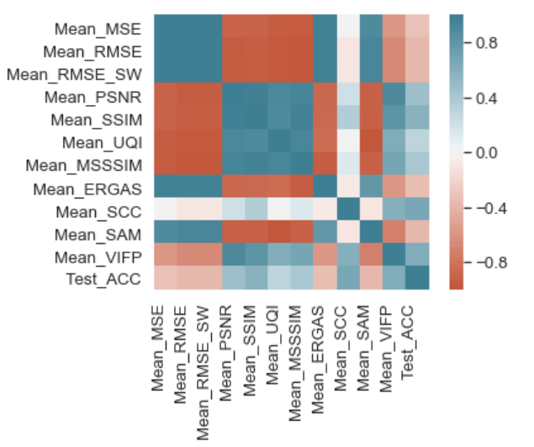
Identification Experiments
Overall correlation heatmap for similarity metrics and DNN accuracies
The most relevant metric is Mean Spatial Correlation Coefficient (Mean-SCC)
Notes:
This is overall correlation heatmap for 10 similarity metrics and DNN accuracies. The cool color means the low correlation level between a similarity metric and DNN accuracy, and the warm color means the high correlation level between similarity metric and DNN accuracy. From this figure, we can see the most relevant metric is Mean Spatial Correlation Coefficients (Mean-SCC).

Slide 13
Identification Experiments
Correlation lines between Mean-SCC and DNN accuracies on 3 datasets
The higher Mean-SCC value, the higher DNN accuracy
Notes:
The three figures show the correlation lines between Mean-SCC and DNN accuracies on CIFAR 10, CIFAR 100, and STL 10 Dataset. We can conclude that the DNN accuracy is linear related to the Mean-SCC metric. Thus, the Mean-SCC can be used as the indicator of the DNN accuracy.

Slide 14
Balance Security and Accuracy
We can choose a proper image filtering techniques and parameters according to the Mean-SCC metric.
Remaining Issues
In many instances, the DNN accuracy is still not satisfied due to low image quality.
Federated Cloud Based DNN models
to improve DNN accuracy while protecting user privacy.
Notes:
So, we can choose proper image filtering techniques and parameters according to the Mean-SCC metric before training. But there are still some remaining issues. In many instances, the low DNN accuracy is still not satisfied due to low image quality. Therefore, we propose federated cloud based DNN models to improve DNN accuracy while protecting user privacy.

Slide 15
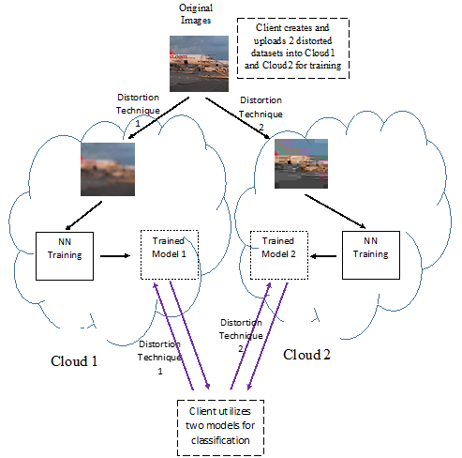
Federated Cloud Based DNN Models
Apply different filtering techniques
generate different filtered datasets
distort different image information
Multiple clouds separately train DNN models
high privacy protection levels
profile different image features
Model Merging
merge different models via transfer learning
Notes:
Let's see the workflow of federated cloud based DNN models. First, we apply different filtering techniques to generate different filtered datasets. For each dataset, the filtering technique distort different image information. Second, we let multiple clouds separately train DNN models with different filtered dataset. In this way, each cloud only observe one dataset so that the high privacy protection can be guaranteed. Besides, since each cloud can profile different image features, we can combine these clouds to obtain a well-performance model. So finally, we merge different models trained by multiple clouds via transfer learning.

Slide 16
Model Merging
Transfer Learning
add several classification layers on original DNN models
optimize the parameters of additional layers
Hierarchical Transfer Learning
Tree Leaf
original DNN model
Tree Node
classification layer upon lower layers
Notes:
Generally speaking, transfer Learning can combine different DNN models by adding several classification layers on original models and optimizes the parameters. And Hierarchical Transfer Learning is shown in the right figure. It is a tree-like structure. The tree leaf is an original DNN model, and the tree node is a classification layer upon lower layers.

Slide 17
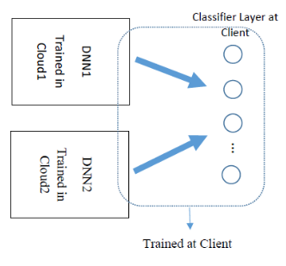
Model Merging
2-Cloud Federated Learning
4-Cloud Federated Learning
Notes:
The figure shows the two types of federated learning, the left is 2-cloud federated learning and the right is 4-cloud federated learning.

Slide 18
Experiments
STL10 dataset
choose proper parameters and types of filtering techniques
Mean-SCC values between 0.5 and 0.8
(1) Blur_1, (2) JPEG_30, (3) MedianFilter_3, (4) CONTOUR, (5) EMBOSS, (6) FIND_EDGES
Notes:
Then, to evaluate our new models, we use STL10 dataset to generate different filtered images. And we choose proper parameters and types of filtering techniques with the Mean-SCC values between 0.5 and 0.8, which results in proper distortion levels with relatively high DNN accuracies. Eventually, we select 6 image filtering techniques to generate filtered images and distribute images to 6 clouds.

Slide 19
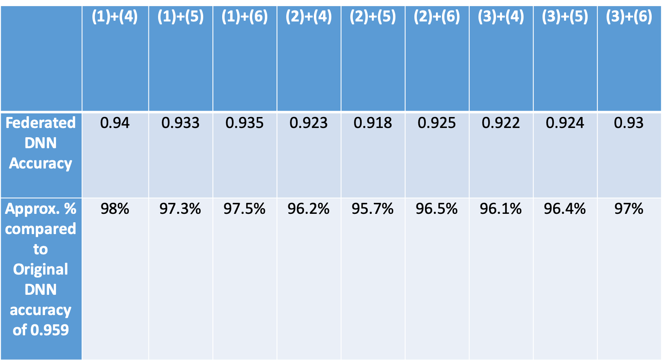
Experiments
2-Cloud Federated Learning Results
Original DNN model shows the testing accuracy of 0.959
Notes:
This figure shows the DNN accuracy of two-cloud federated learning. In experiments, we measure the results of different combinations of two clouds. We can see the federated DNN accuracy ranges from 0.918 from 0.94, which is close to the accuracy of original DNN model trained with original dataset, say 0.958.

Slide 20
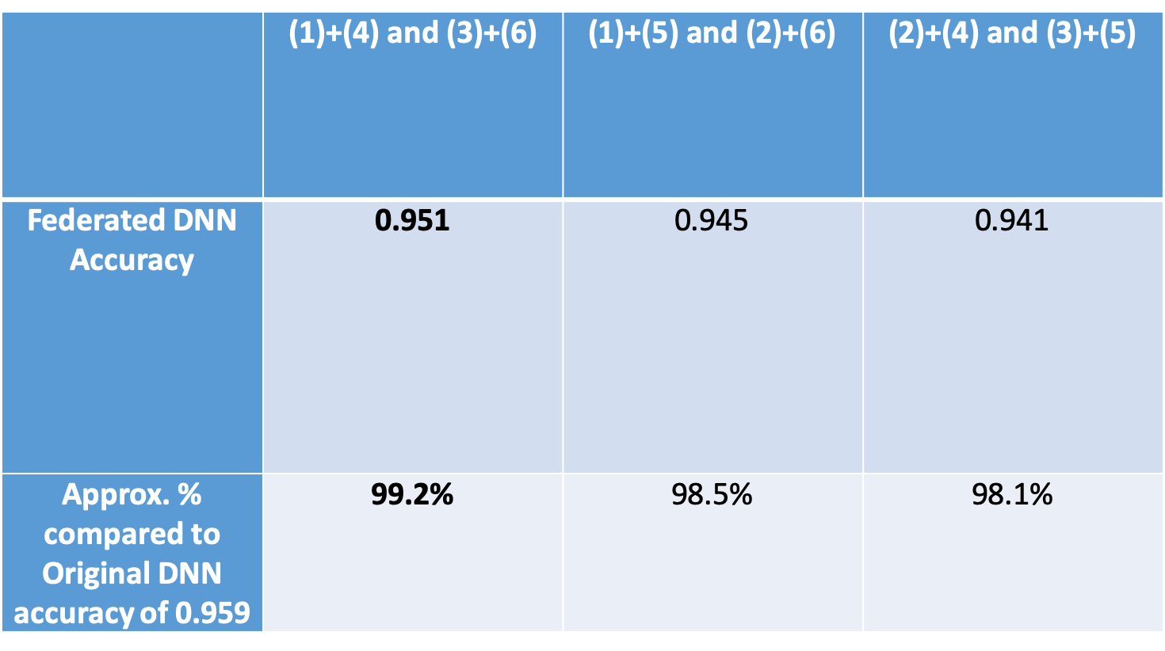
Experiments
4-Cloud Federated Learning Results
Notes:
Also, we measure 4-cloud federated learning results. The highest DNN accuracy is very near original DNN accuracy, which shows the approximation percentage of 0.992.

Slide 21
Conclusions
New mechanism for privacy preserving Cloud-based DNN training/classification.
Use image filtering techniques for application specific privacy protection.
Identification of similarity metrics
Indicate privacy protection levels
Reveal DNN accuracies
Federated-Cloud based DNN learning model is proposed for enhancing the DNN accuracy while providing privacy protection
Notes:
OK, let me conclude our work. First, we discuss the new mechanism for privacy preserving Cloud-based DNN training/classification, which uses image filtering techniques for application-specific privacy protection. Second, we identify a similarity metric to indicate privacy protection levels and reveal DNN accuracies. Third, we further propose a federated cloud based DNN learning model to enhance DNN accuracies.

Slide 22
Thank you!

